Slide 1

Select Topics in Python
Creating and Using Sets
Notes:
‹#›

Slide 2

Objectives
Objectives
Introduction sets.
Implementation of sets.
Using range function.
Iterate through a set.
Set operations.
Set functions.
Notes:
‹#›

Slide 3
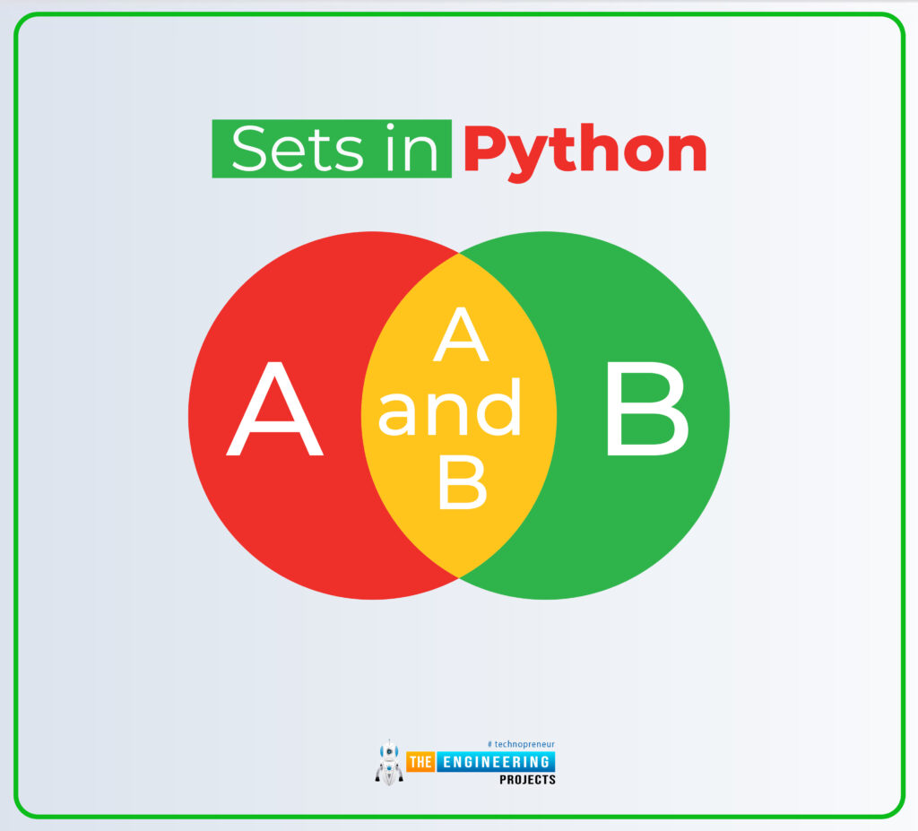
Introduction Sets
Sets
Unordered collection.
Iterable.
Mutable.
No duplications.
Also know as a hash table.
Notes:
A set is an unordered collection of items.
Every element must be unique and immutable.
Duplicates are eliminated
Elements are Immutable like tuples, integers, strings etc.
However, the set itself is mutable.
It is possible to add or remove items to set.
We can change its state—its length and content.
Sets can be used to perform mathematical set operations like union, intersection, symmetric difference etc.
SETS Don’t SUPPORT INDEXING
Image from: https://www.theengineeringprojects.com/2022/03/how-to-use-sets-in-python.html
‹#›

Slide 4
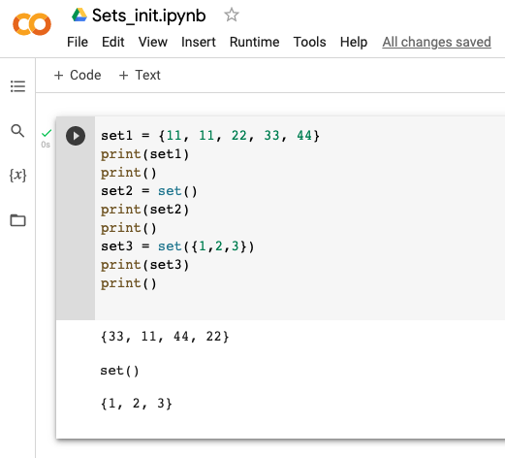
Implementation of a Set
Set
Empty set.
Defined set.
Set method.
Notes:
‹#›

Slide 5
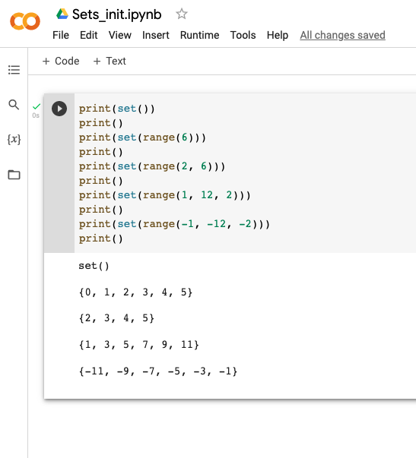
Using the Range Function
Range
Using 1, 2, and/or 3 consists.
Notes:
‹#›

Slide 6
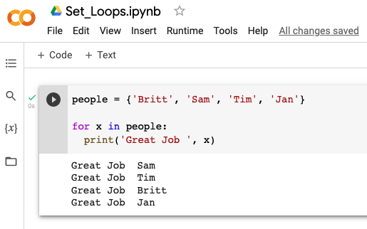
Iterate Through a Set
Iteration
For loop.

Slide 7
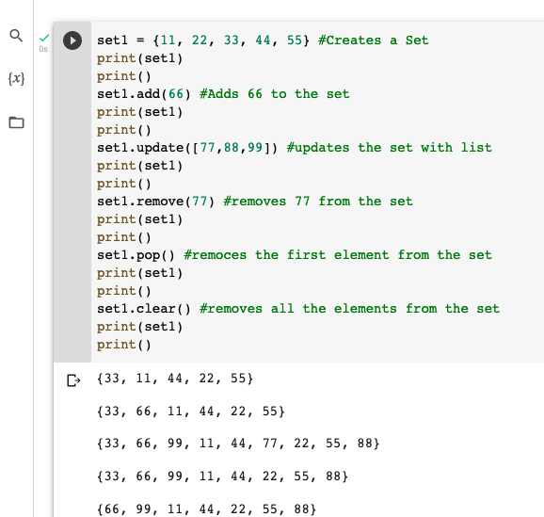
Set Operations
Sets are mutable
add()
update()
pop()
remove()
clear()
Notes:
add() : It takes one element and adds this element to the set.
update(): It takes string/set/tuple/list/dictionary and adds all elements to the set.
pop(): It removes one item from the set and returns it. Set being unordered, there is no way of determining which item will be popped. It is completely arbitrary.
remove() : It removes an element from a set. If the element is not a member, raise a KeyError
clear(): This function remove all items from a set.
isdisjoint() ---- Return True if two sets have a null intersection
issubset() ----Return True if another set contains this set
issuperset() ----Return True if this set contains another set
discard() ---Remove an element from set if it is a member. (Do nothing if the element is not in set)
copy() ---- Return a copy of a set
‹#›

Slide 8
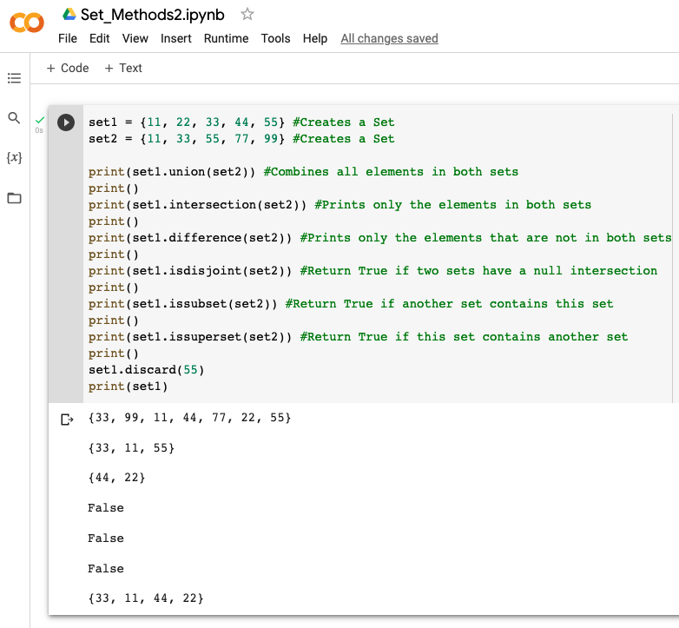
Set Operations (continued)
Sets are mutable
union()
intersection()
difference()
isdisjoint()
issubset()
issuperset()
discard()
copy()
Notes:
This method is different from the remove() method, because the remove() method will raise an error if the specified item does not exist, and the discard() method will not.
‹#›

Slide 9
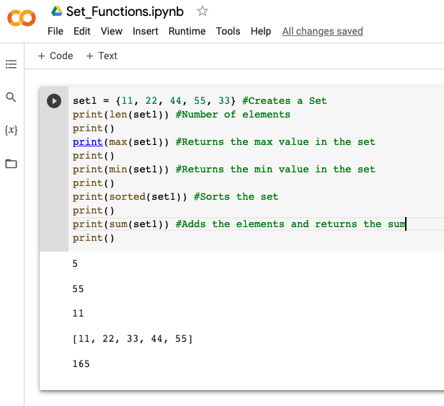
Function in Sets
Function
len()
max()
min()
sorted()
sum()
Notes:
‹#›

